Slide 1
Bubble sort

Slide 2
Outline
The second sorting algorithm is the O(n²) bubble sort algorithm
Uses an opposite strategy from insertion sort
We will examine:
The algorithm and an example
Run times
best case
worst case
average case (introducing inversions)
Summary and discussion

Slide 3
Description
8.3
Suppose we have an array of data which is unsorted:
Starting at the front, traverse the array, find the largest item, and move (or bubble) it to the top
With each subsequent iteration, find the next largest item and bubble it up towards the top of the array

Slide 4
Description
8.3
As well as looking at good algorithms, it is often useful too look at sub-optimal algorithms
Bubble sort is a simple algorithm with:
a memorable name, and
a simple idea
It is also significantly worse than insertion sort

Slide 5
Observations
8.3
Some thoughts about bubble sort:
the Jargon file states that bubble sort is
“the generic bad algorithm”
Donald Knuth comments that
“the bubble sort seems to have nothing to recommend it, except a catchy name and the fact that it leads to some interesting theoretical problems”

Slide 6

Obama on bubble sort
8.3
When asked the most efficient way to sort a million 32-bit integers, Senator Obama had an answer:
http://www.youtube.com/watch?v=k4RRi_ntQc8

Slide 7
Implementation
8.3.1
Starting with the first item, assume that it is the largest
Compare it with the second item:
If the first is larger, swap the two,
Otherwise, assume that the second item is the largest
Continue up the array, either swapping or redefining the largest item

Slide 8
Implementation
8.3.1
After one pass, the largest item must be the last in the list
Start at the front again:
the second pass will bring the second largest element into the second last position
Repeat n – 1 times, after which, all entries will be in place

Slide 9
Implementation
8.3.1
The default algorithm:
template <typename Type>
void bubble( Type *const array, int const n ) {
for ( int i = n - 1; i > 0; --i ) {
for ( int j = 0; j < i; ++j ) {
if ( array[j] > array[j + 1] ) {
std::swap( array[j], array[j + 1] );
}
}
}
}

Slide 10
The Basic Algorithm
8.3.1
Here we have two nested loops, and therefore calculating the run time is straight-forward:

Slide 11
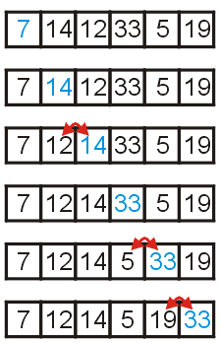
Example
8.3.1
Consider the unsorted array to the right
We start with the element in the first location, and move forward:
if the current and next items are in order, continue with the next item, otherwise
swap the two entries

Slide 12
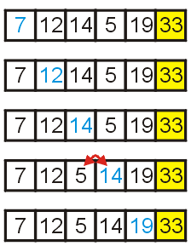
Example
8.3.1
After one loop, the largest element is in the last location
Repeat the procedure

Slide 13
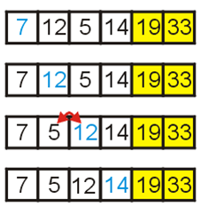
Example
8.3.1
Now the two largest elements are at the end
Repeat again

Slide 14
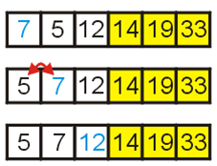
Example
8.3.1
With this loop, 5 and 7 are swapped

Slide 15
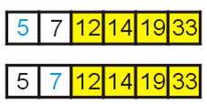
Example
8.3.1
Finally, we swap the last two entries to order them
At this point, we have a sorted array

Slide 16
Implementations and Improvements
8.3.2
The next few slides show some implementations of bubble sort together with a few improvements:
reduce the number of swaps,
halting if the list is sorted,
limiting the range on which we must bubble, and
alternating between bubbling up and sinking down

Slide 17
First Improvement
8.3.2.1
We could avoid so many swaps...
template <typename Type>
void bubble( Type *const array, int const n ) {
for ( int i = n - 1; i > 0; --i ) {
Type max = array[0]; // assume a[0] is the max
for ( int j = 1; j <= i; ++j ) {
if ( array[j] < max ) {
array[j - 1] = array[j]; // move
} else {
array[j – 1] = max; // store the old max
max = array[j]; // get the new max
}
}
array[i] = max; // store the max
}
}

Slide 18
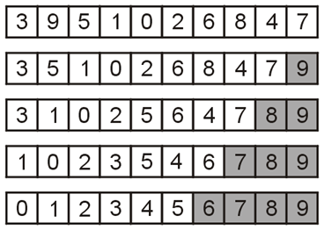
Flagged Bubble Sort
8.3.2.2
One useful modification would be to check if no swaps occur:
If no swaps occur, the list is sorted
In this example, no swaps occurred during the 5th pass
Use a Boolean flag to check if no swaps occurred

Slide 19
Flagged Bubble Sort
8.3.2.2
Check if the list is sorted (no swaps)
template <typename Type>
void bubble( Type *const array, int const n ) {
for ( int i = n - 1; i > 0; --i ) {
Type max = array[0];
bool sorted = true;
for ( int j = 1; j < i; ++j ) {
if ( array[j] < max ) {
array[j - 1] = array[j];
sorted = false;
} else {
array[j – 1] = max;
max = array[j];
}
}
array[i] = max;
if ( sorted ) {
break;
}
}
}

Slide 20
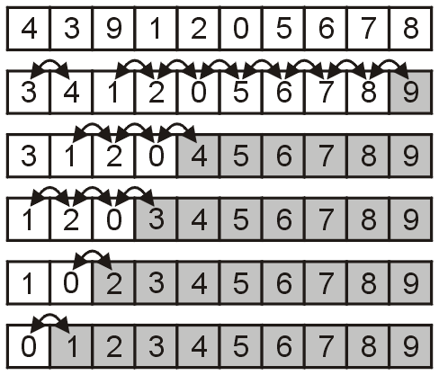
Range-limiting Bubble Sort
8.3.2.3
Intuitively, one may believe that limiting the loops based on the location of the last swap may significantly speed up the algorithm
For example, after the second pass, we are certain all entries after 4 are sorted
The implementation is easier than that for using a Boolean flag

Slide 21
Range-limiting Bubble Sort
8.3.2.3
Update i to at the place of the last swap
template <typename Type>
void bubble( Type *const array, int const n ) {
for ( int i = n - 1; i > 0; ) {
Type max = array[0];
int i = 0;
for ( int j = 1; j < i; ++j ) {
if ( array[j] < max ) {
array[j - 1] = array[j];
i = j - 1;
} else {
array[j – 1] = max;
max = array[j];
}
}
array[i] = max;
}
}

Slide 22
Range-limiting Bubble Sort
8.3.2.3
Unfortunately, in practice, this does little to affect the number of comparisons

Slide 23
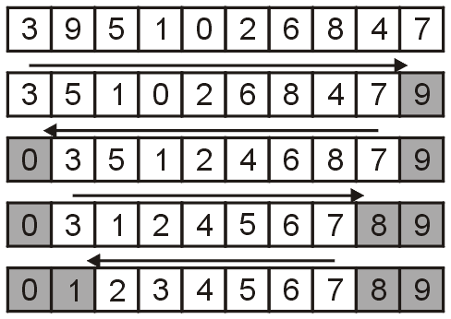
Alternating Bubble Sort
8.3.2.4
One operation which does significantly improve the run time is to alternate between
bubbling the largest entry to the top, and
sinking the smallest entry to the bottom
This does, we will see, make a significant improvement

Slide 24
Alternating Bubble Sort
8.3.2.4
Alternating between bubbling and sinking:
template <typename Type>
void bubble( Type *const array, int n ) {
int lower = 0;
int upper = n - 1;
while ( true ) {
int new_upper = lower;
for ( int i = lower; i < upper; ++i ) {
if ( array[i] > array[i + 1] ) {
Type tmp = array[i];
array[i] = array[i + 1];
array[i + 1] = tmp;
new_upper = i;
}
}
upper = new_upper;
if ( lower == upper ) {
break;
}
int new_lower = upper;
for ( int i = upper; i > lower; --i ) {
if ( array[i - 1] > array[i] ) {
Type tmp = array[i];
array[i] = array[i - 1];
array[i - 1] = tmp;
new_lower = i;
}
}
lower = new_lower;
if ( lower == upper ) {
break;
}
}
}
Bubble up to the back
Sink down to the front

Slide 25
Run-time Analysis
8.3.2.4
Because the bubble sort simply swaps adjacent entries, it cannot be any better than insertion sort which does n + d comparisons where d is the number of inversions
Unfortunately, it isn’t that easy:
There are numerous unnecessary comparisons

Slide 26
Empirical Analysis
8.3.3
The next slide map the number of required comparisons necessary to sort 32768 arrays of size 1024 where the number of inversions range from 10000 to 523776
Each point (d, c) is the number of inversions in an unsorted list d and the number of required comparisons c

Slide 27
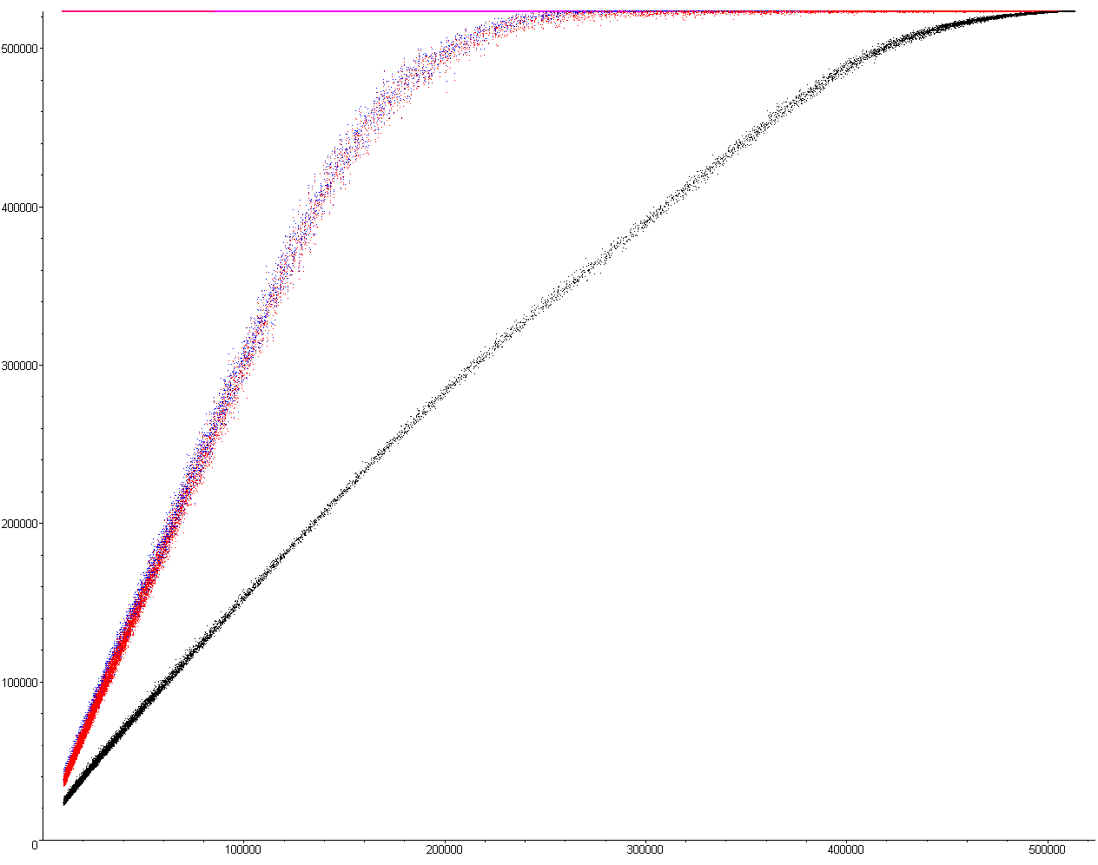
Empirical Analysis
8.3.3
The following for plots show the required number of comparisons required to sort an array of size 1024
Comparisons
Basic implementation —— Flagged —— Range limiting —— Alternating ——
d

Slide 28
Empirical Analysis
8.3.3
The number of comparisons with the flagged/limiting sort is initially n + 3d
For the alternating variation, it is initially n + 1.5d
Comparisons
Basic implementation —— Flagged —— Range limiting —— Alternating ——
d

Slide 29
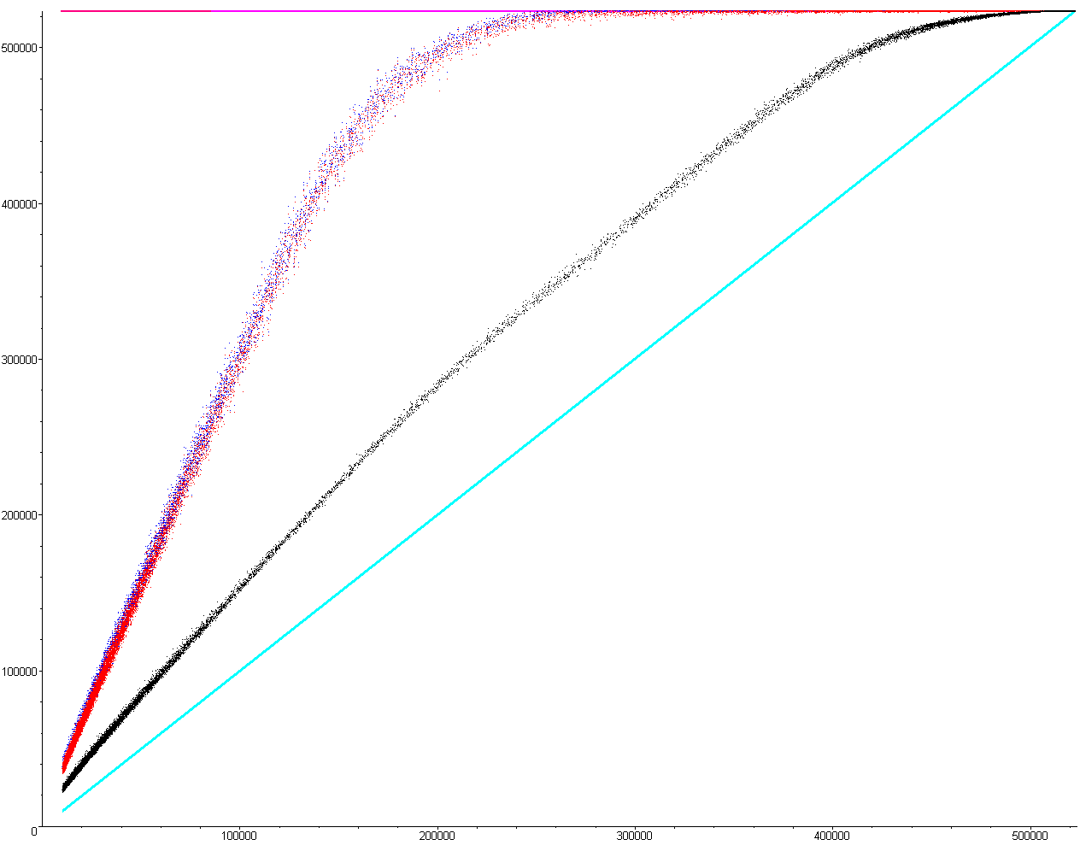
Empirical Analysis
8.3.3
Unfortunately, the comparisons for insertion sort is n + d which is better in all cases except when the list is
Sorted, or
Reverse sorted
Comparisons
Basic implementation —— Flagged —— Range limiting —— Alternating ——
Insertion Sort ——
d

Slide 30
Run-Time
8.3.4
The following table summarizes the run-times of our modified bubble sorting algorithms; however, they are all worse than insertion sort in practice
Case | Run Time | Comments
Worst | Θ(n²) | Θ(n²) inversions
Average | Θ(n + d) | Slow if d = ω(n)
Best | Θ(n) | d = O(n) inversions

Slide 31
Summary
8.3.4
In this topic, we have looked at bubble sort
From the description, it sounds as if it is as good as insertion sort
it has the same asymptotic behaviour
in practice, however, it is significantly worse
it is also much more difficult to code...

Slide 32
References
Wikipedia, http://en.wikipedia.org/wiki/Bubble_sort
[1] Donald E. Knuth, The Art of Computer Programming, Volume 3: Sorting and Searching, 2nd Ed., Addison Wesley, 1998, §5.2.2, p.106-9.
These slides are provided for the ECE 250 Algorithms and Data Structures course. The material in it reflects Douglas W. Harder’s best judgment in light of the information available to him at the time of preparation. Any reliance on these course slides by any party for any other purpose are the responsibility of such parties. Douglas W. Harder accepts no responsibility for damages, if any, suffered by any party as a result of decisions made or actions based on these course slides for any other purpose than that for which it was intended.

